Slide 1
Home Loan default Prediction
Sprint 3
Lakshmi Anantha Krishnan

Slide 2
Problem Statement
How might we use machine learning to predict home loan defaults such that we can reduce financial losses and improve loan management?
Proposed Solution:
Develop machine learning models to predict home loan defaults.
Use advanced techniques to improve model accuracy and reliability.
Potential Impact:
Reduced financial losses for lenders.
Better loan management and decision-making processes.
Improved financial stability and customer satisfaction.

Slide 3
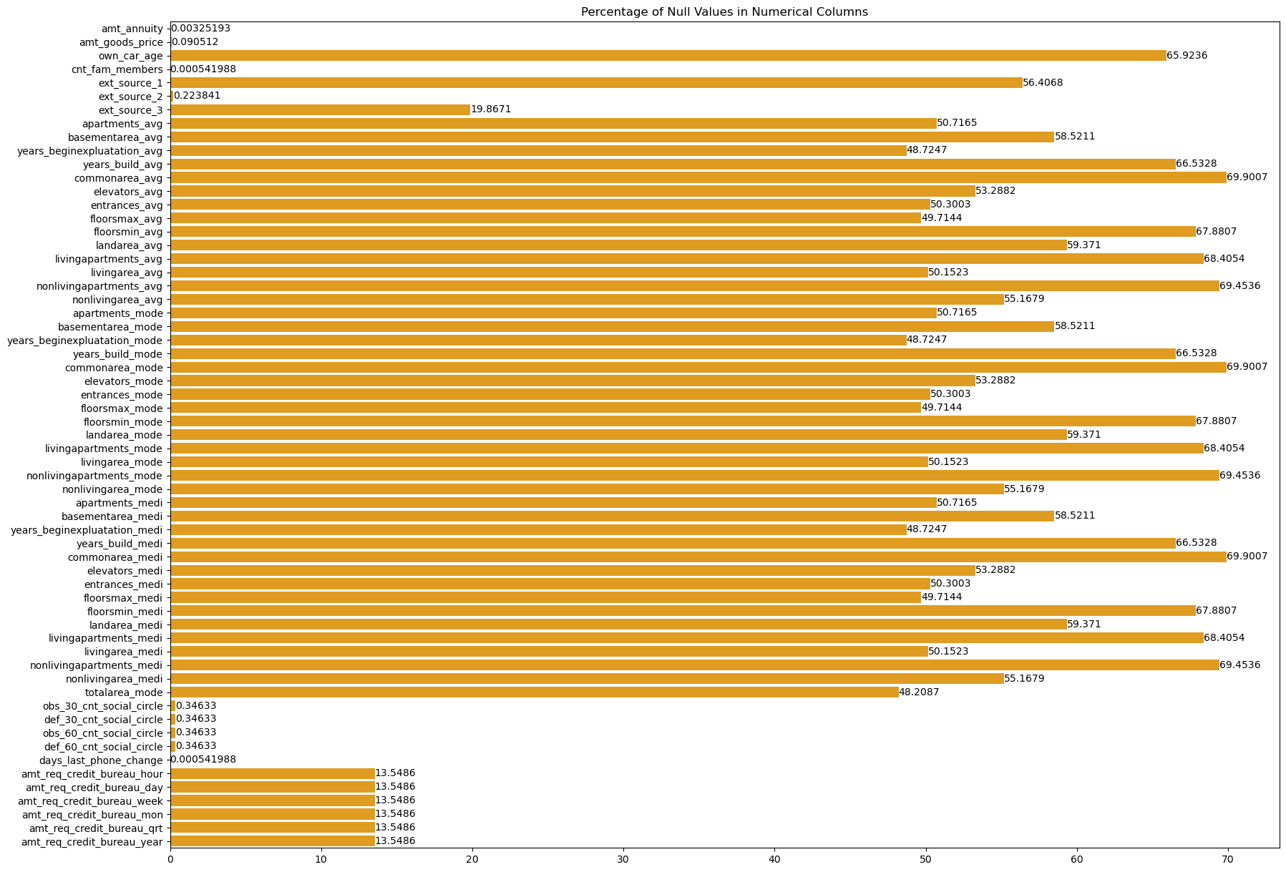
Dataset and Preprocessing
Dataset Shape: (184506, 122)
Deleted more than 20% of NULL
The total number of rows dropped is 64306
The percentage of rows dropped is 34.85%
Backward Filling method
Forward Filling method

Slide 4
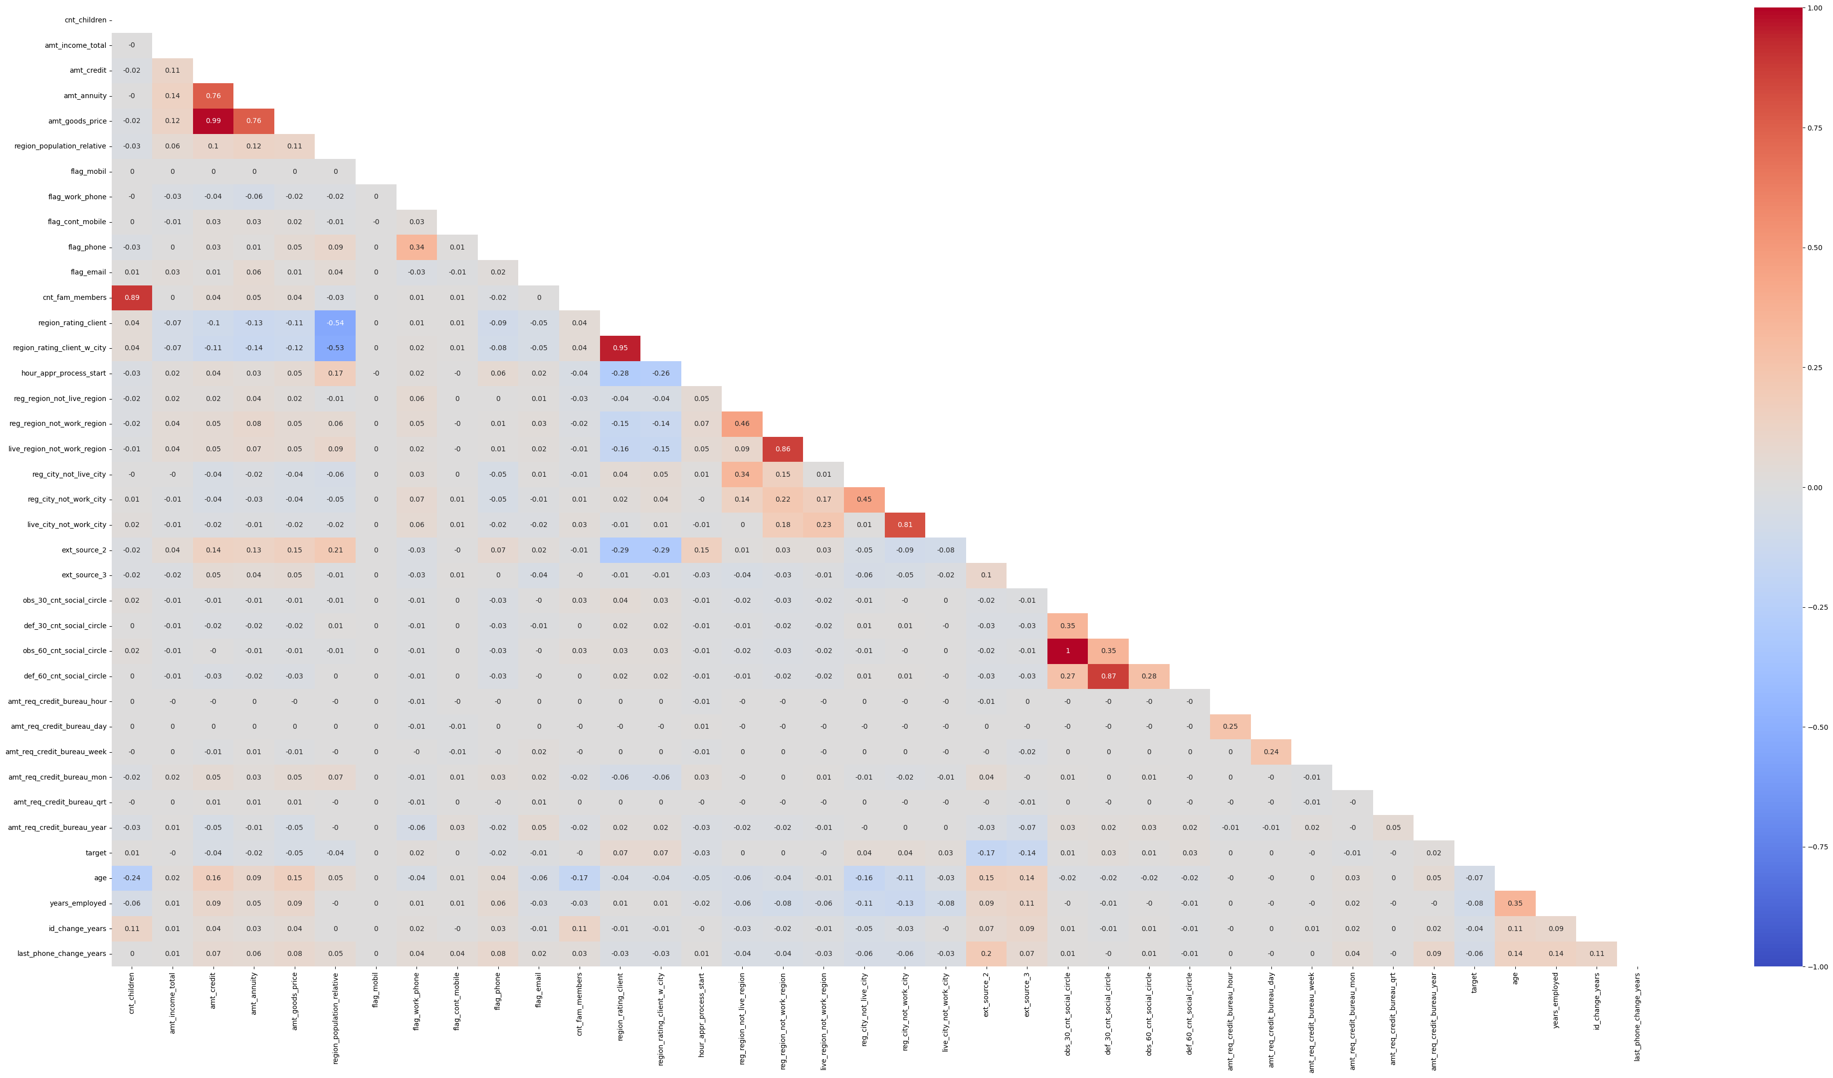
Key Findings from EDA
151249
151249
Imbalanced Dataset – Target Variable
0 91.314867
1 8.685133
Severe Negative correlations with Gender and Own car Variable
Severe Positive correlations with price of home and amount of loan
Over 10 variables with P-values over 0.05
10 Object variables were converted to numerical variables
Severe Multicollinearity issues – Deleted all those variables that had severe multicollinearity issues
Final Dataset Shape: (151249, 32)

Slide 5
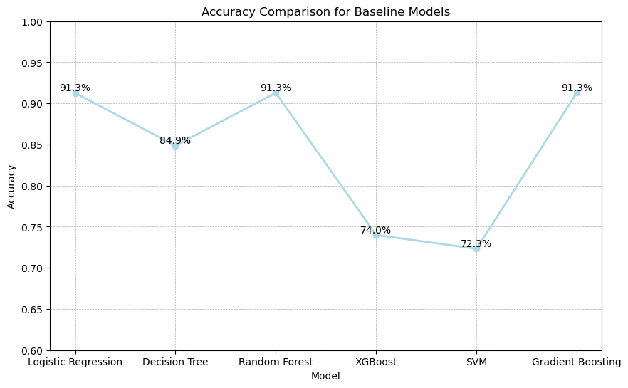
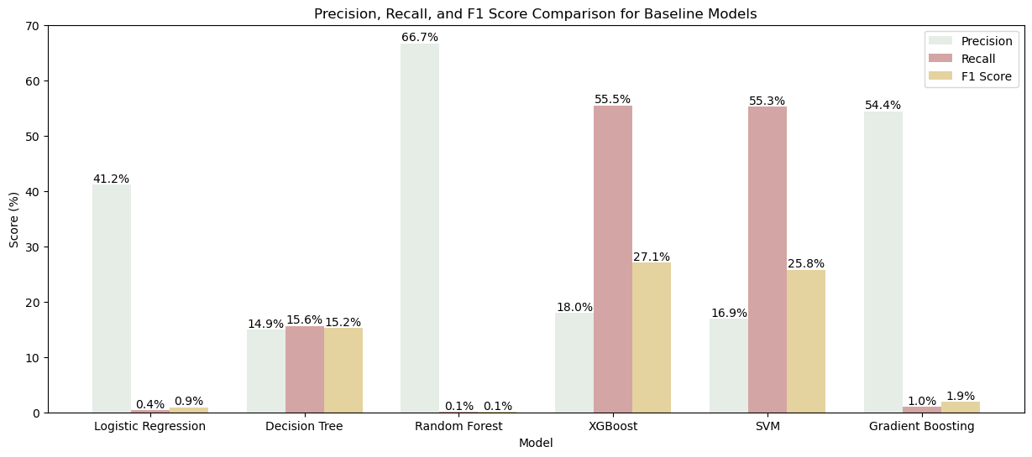
Baseline Models and Evaluation
Models Evaluated(With SMOTE and without):
Logistic Regression
Decision Tree
Random Forest
XGBoost
SVM
Gradient Boosting
Evaluation Metrics:
Accuracy
Precision
Recall
F1 Score
Best out of the 6 models were SVM and XGBoost with similar Recall and Precision

Slide 6
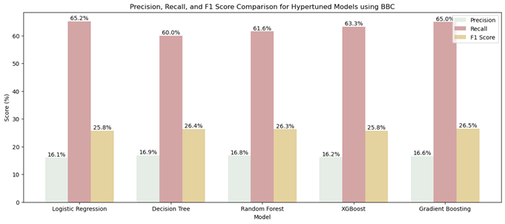
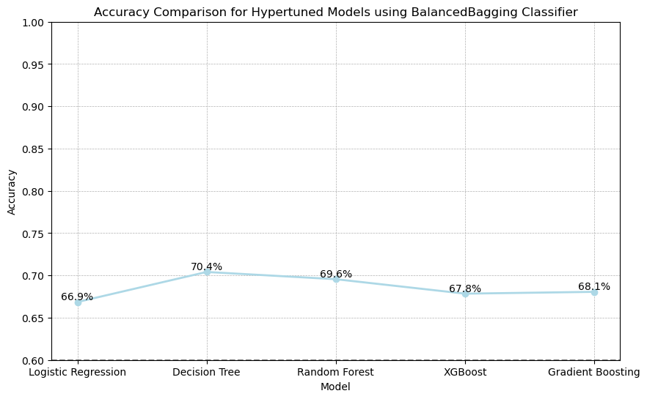
Hyper tuning Models using Ensemble methods
Used Ensemble methods – Balanced Bagging Classifier
Used Logistic Regression, Decision Tree, Random Forest, Xgboost and Gradient Boosting
Gradient Boosting was one of the best among all
Next best is Logistic Regression

Slide 7
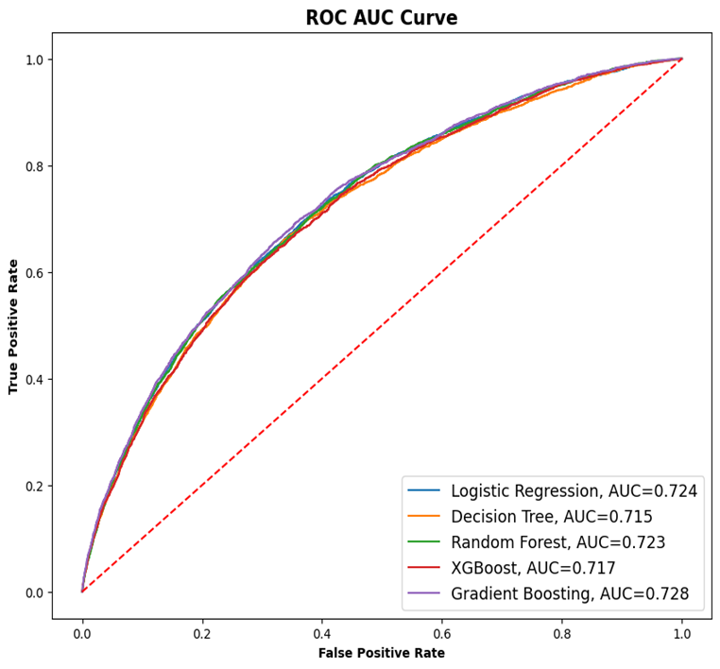
ROC AUC Curve
Logistic Regression, AUC - 0.724 :
Logistic Regression, AUC - 0.724 :
Logistic Regression, AUC - 0.724 :
Logistic Regression, AUC - 0.724 :
Decision Tree, AUC – 0.715
Random Forest, AUC – 0.723
XGBoost, AUC – 0.717
Gradient Boosting, AUC – 0.728

Slide 8
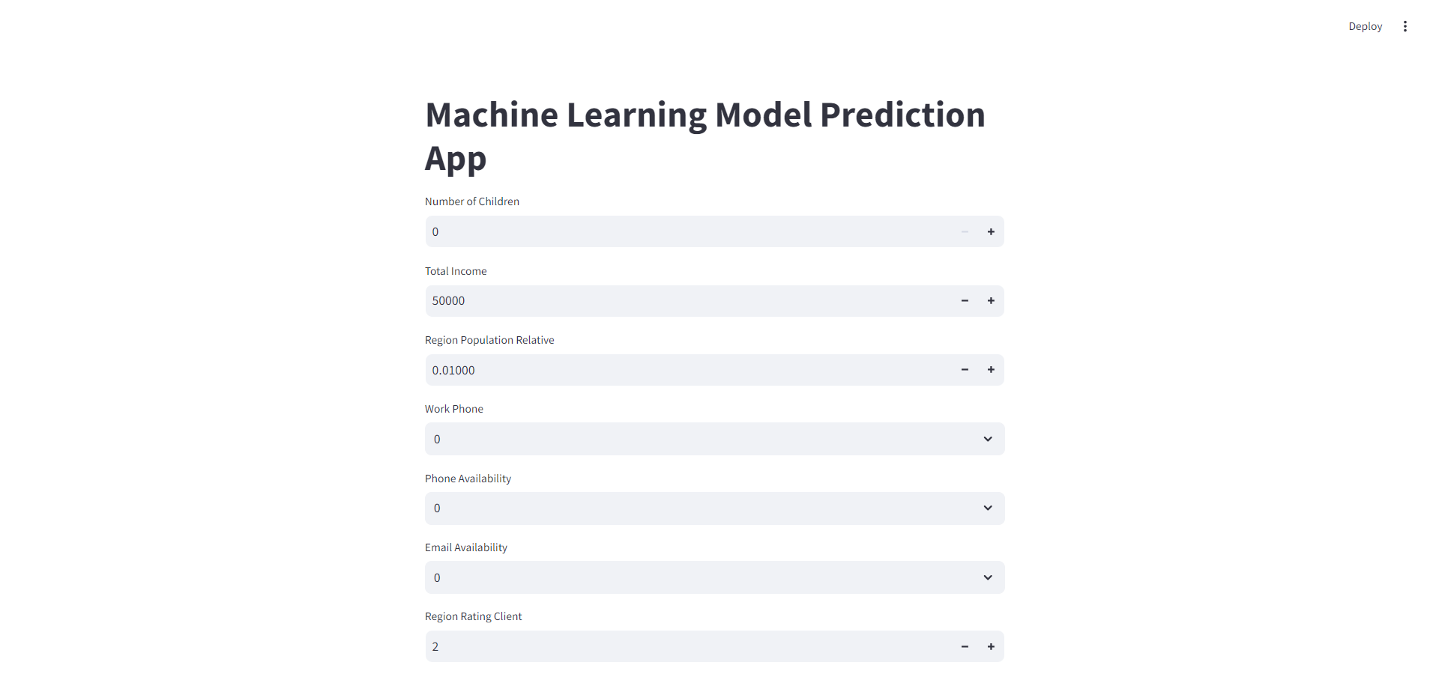
Web App

Slide 9
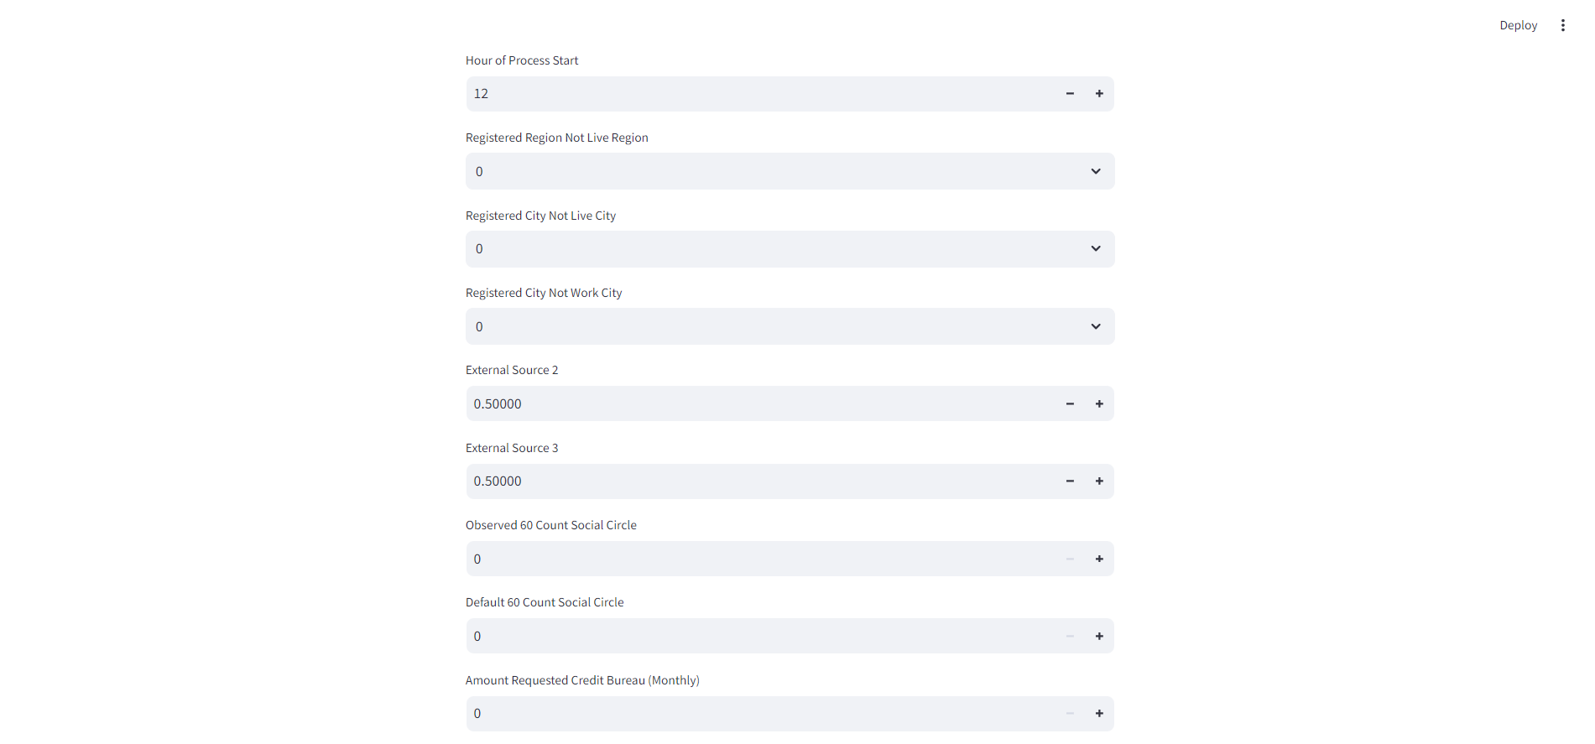

Slide 10
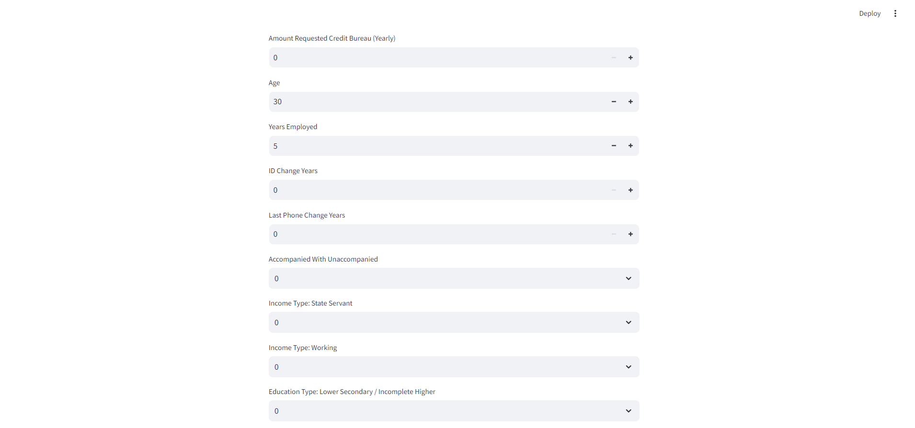

Slide 11
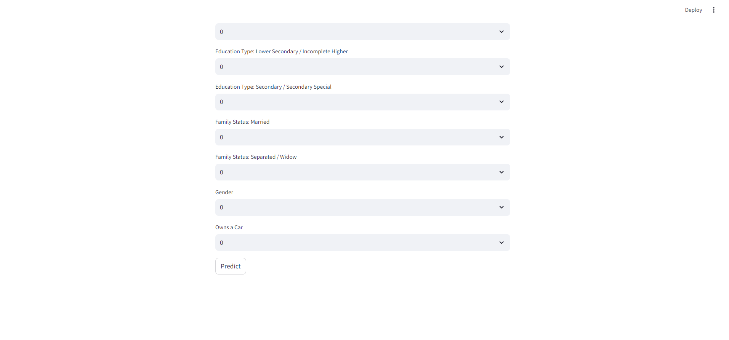

Slide 12
Thank you ☺

